Slide 1

CUSTOMER CHURN PREDICTION
Prepared by:
SYED OWAIS RAZA
Notes:
Photo by Sean Pollock on Unsplash

Slide 2


Introduction
CUSTOMER CHURN
Addressing customer churn is a critical aspect for the success of a business as it helps :
Maintain a loyal customer base
Achieve long-term growth​
Provide valuable insights
Improve profitability
(Armstrong, 2017)
It takes months to find a customer… just seconds to lose one.
This is relevant to anyone interested in business strategy, customer experience, or company growth, making it an informative and practical subject to explore.​

Slide 3
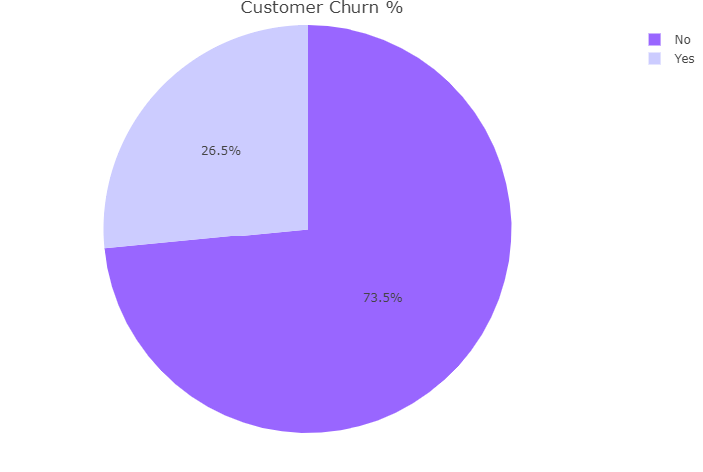
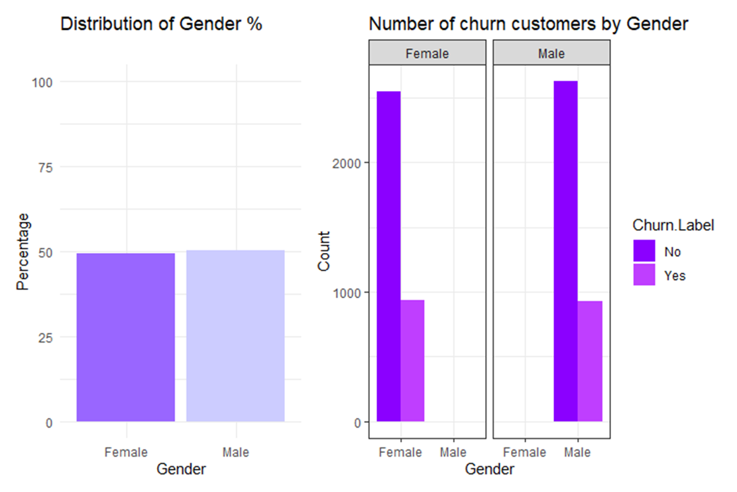
Data Cleaning and Preprocessing
DATA DESCRIPTION
Original 7403 rows and 33 variables
Deleted missing values (0.15%) of total data
Deleted 5 unique columns
Dependent target variable: churn value/label
DAT00148 (ibm.com)
Churn rate is 26.5% although not high but any % of churn rate is a risk
The dataset has approximately equal number of female and male customers.
Percentage of males and females are also equally likely to churn or retain the service.
(Free vector, 2019)

Slide 4
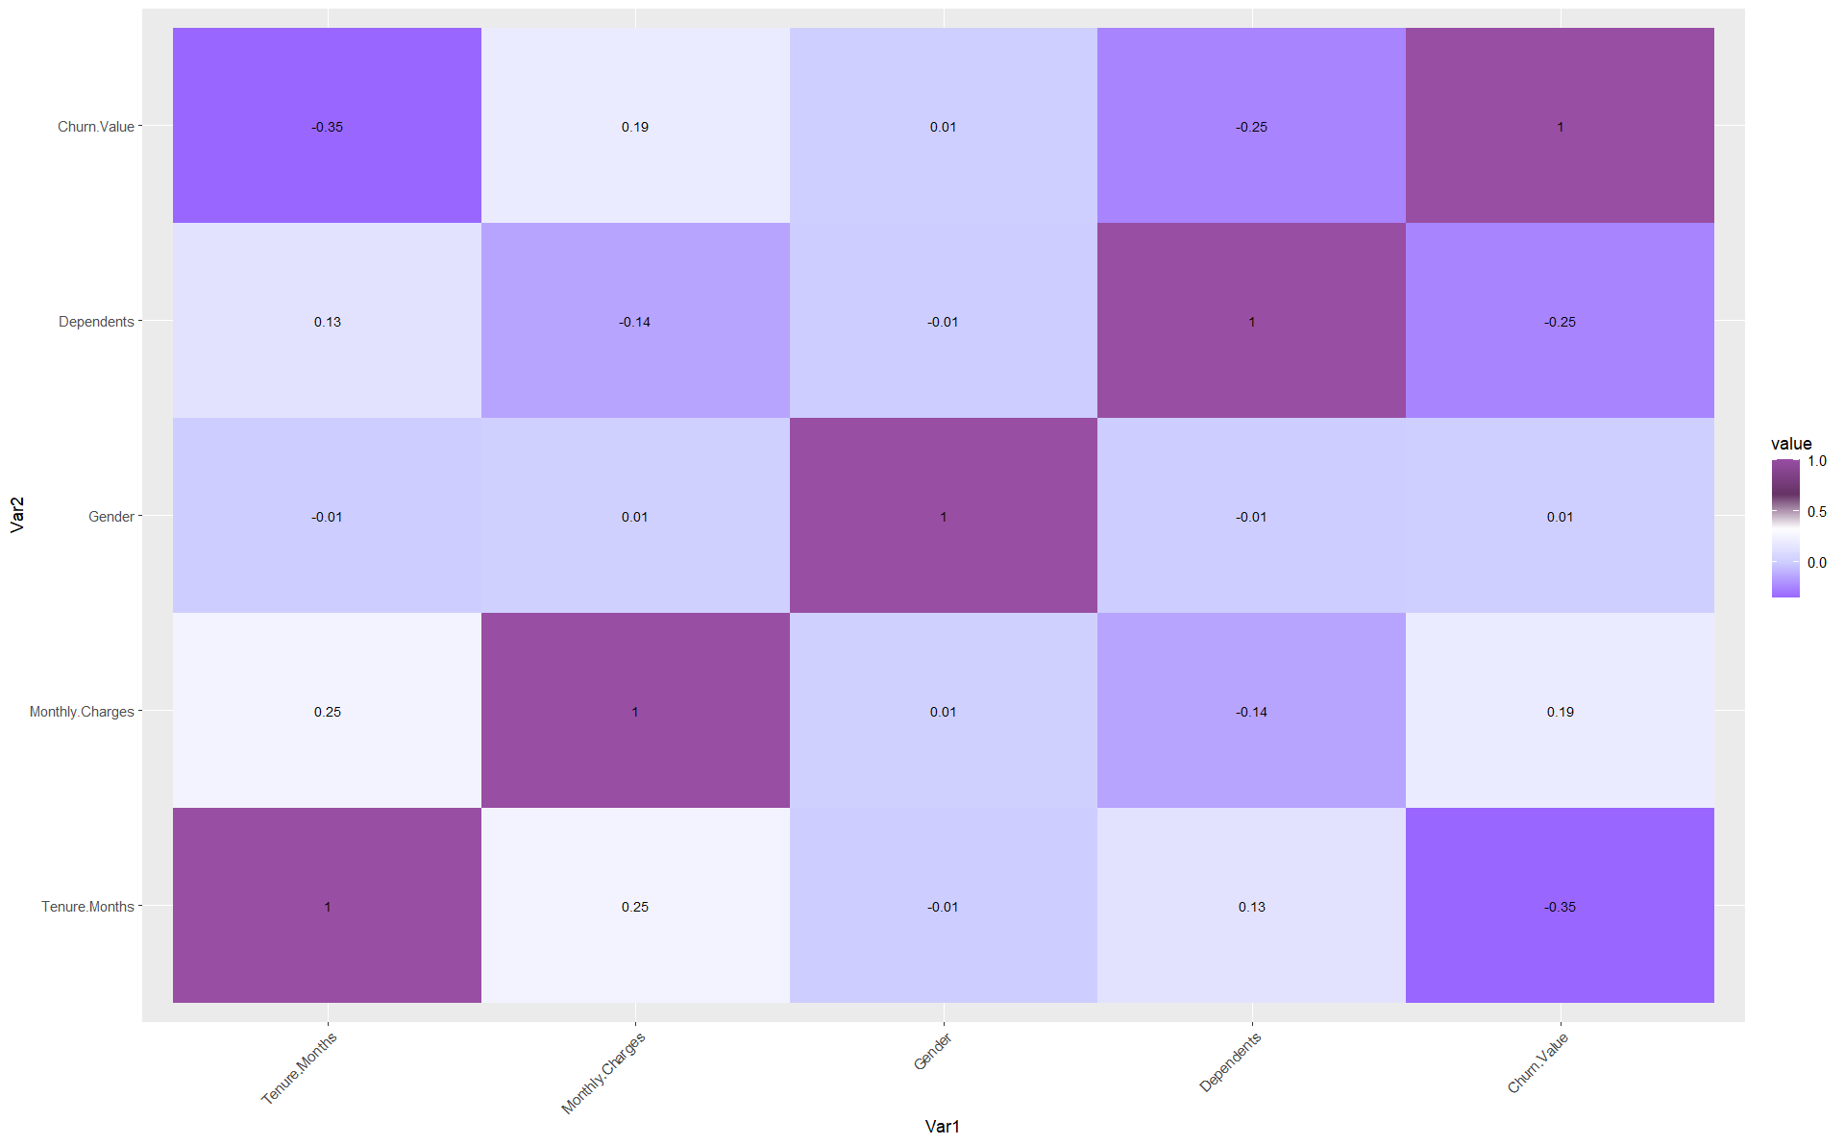
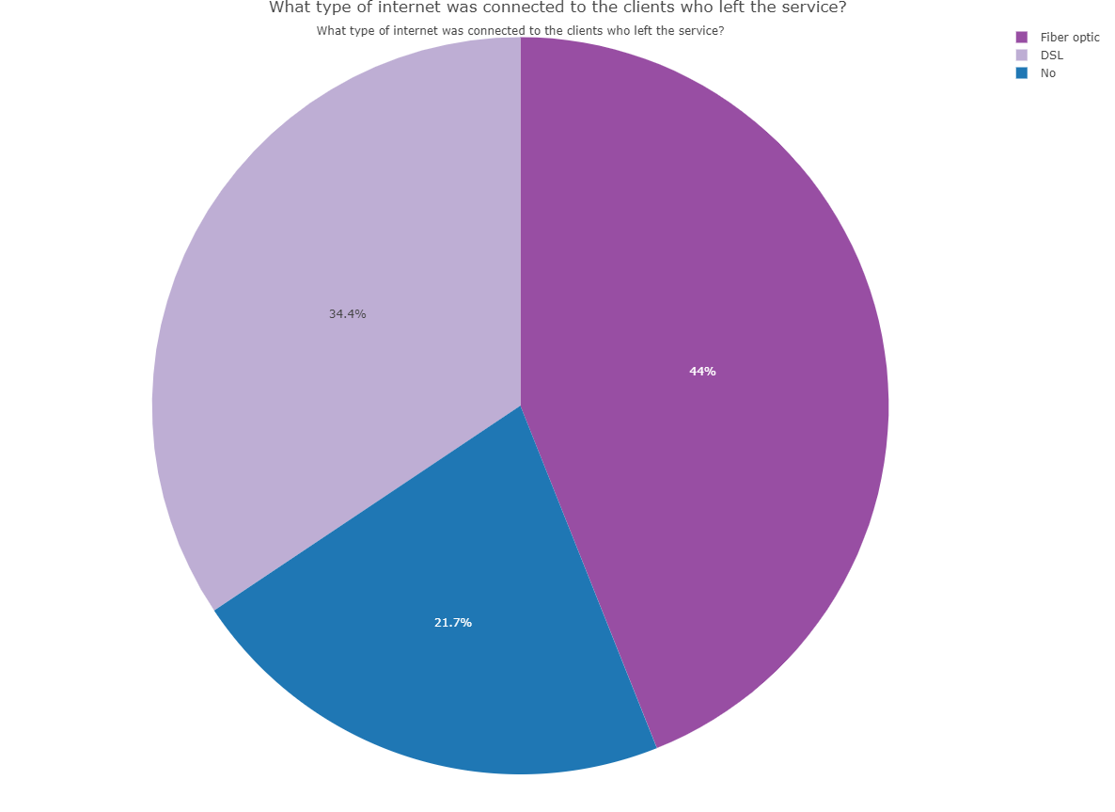
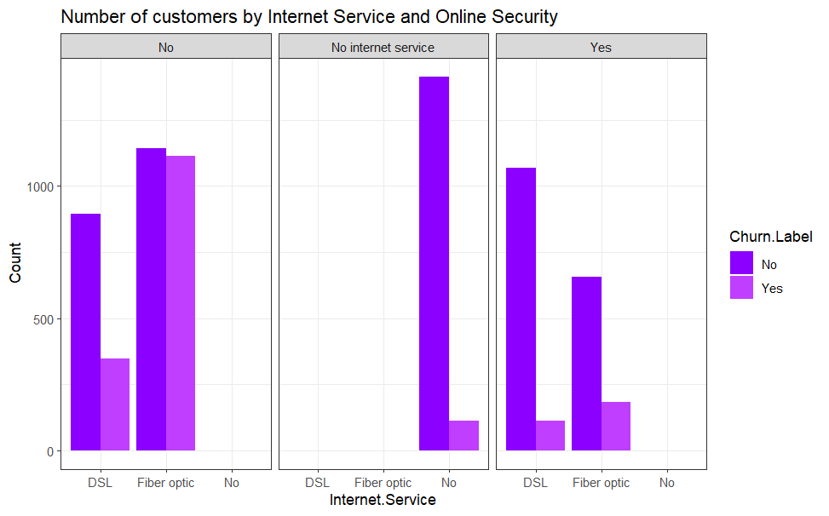
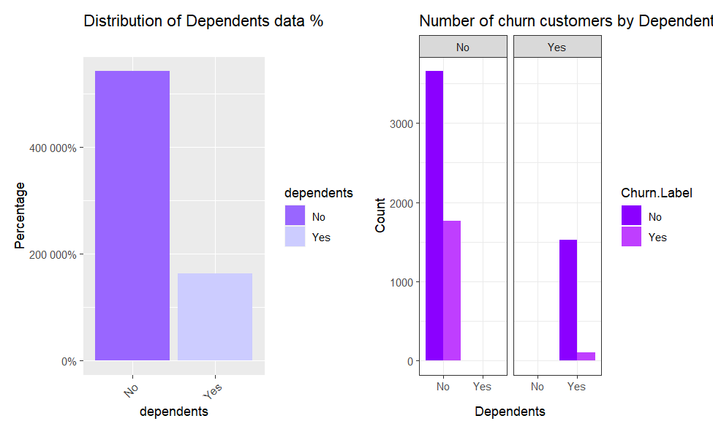
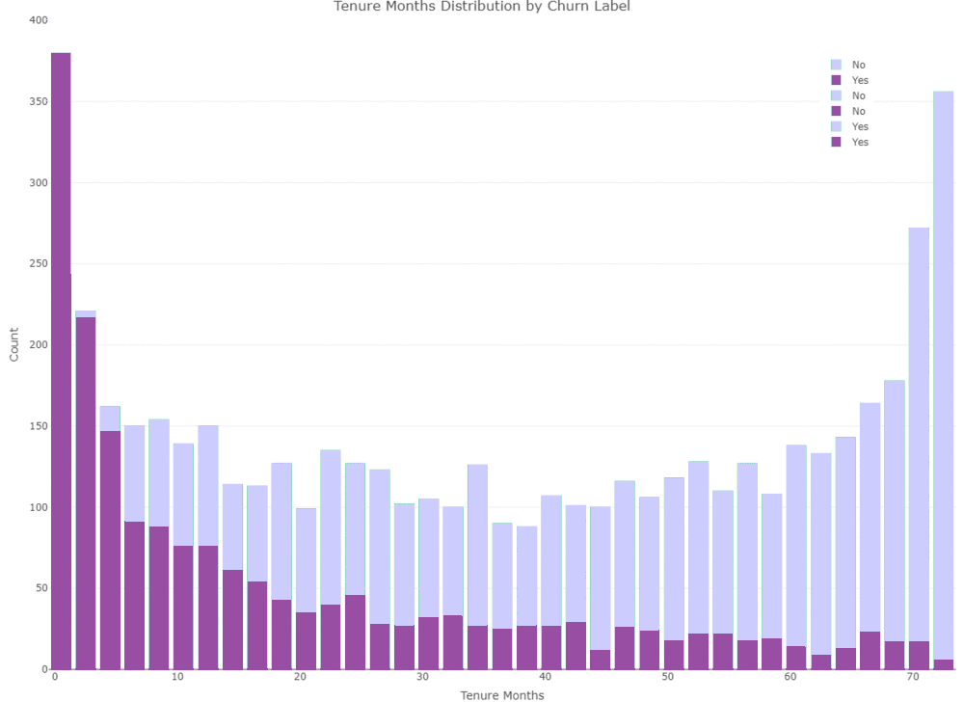
Key Findings
Correlation between different attributes:
With each other
With the target (Churn Value)
20 % of our customers don’t use internet.​
Among those who use, 45 % use Fiber optic and 35% use DSL.​
Among those 45% using Fiber optic 40% churn. ​
50% of the customers who churned, did so in the first 5-10 months.​
The first months in the service are the riskiest, as customers may join while having their own expectations from the company.
Almost 70% of our customers do not have a dependent​
Customers without dependents tend to churn more

Slide 5

Insights and Interpretation
Performance Analysis
60%
Training Data
40%
Testing Data
We split the dataset into training data and testing data.
We chose NAÏVE BAYES after testing the performance of several models including GLM & Decision Tree
We tried different splits in NB and GLM while in DT we tried 5 different folds.
We realised that unlike decision tree, NB does not give definitive rules.
Rules extracted from NB are for features with highest mean probabilities.
(Free vector, 2019)

Slide 6
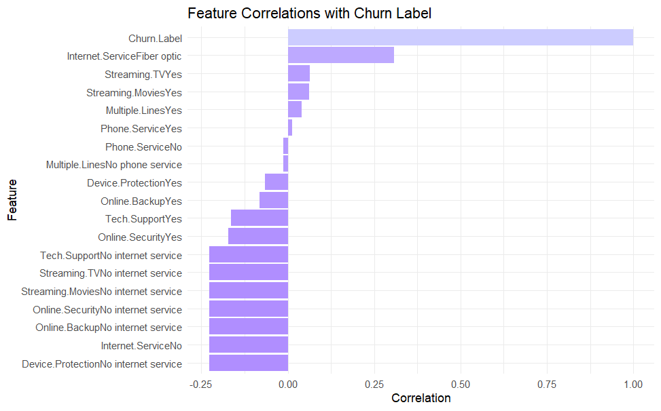
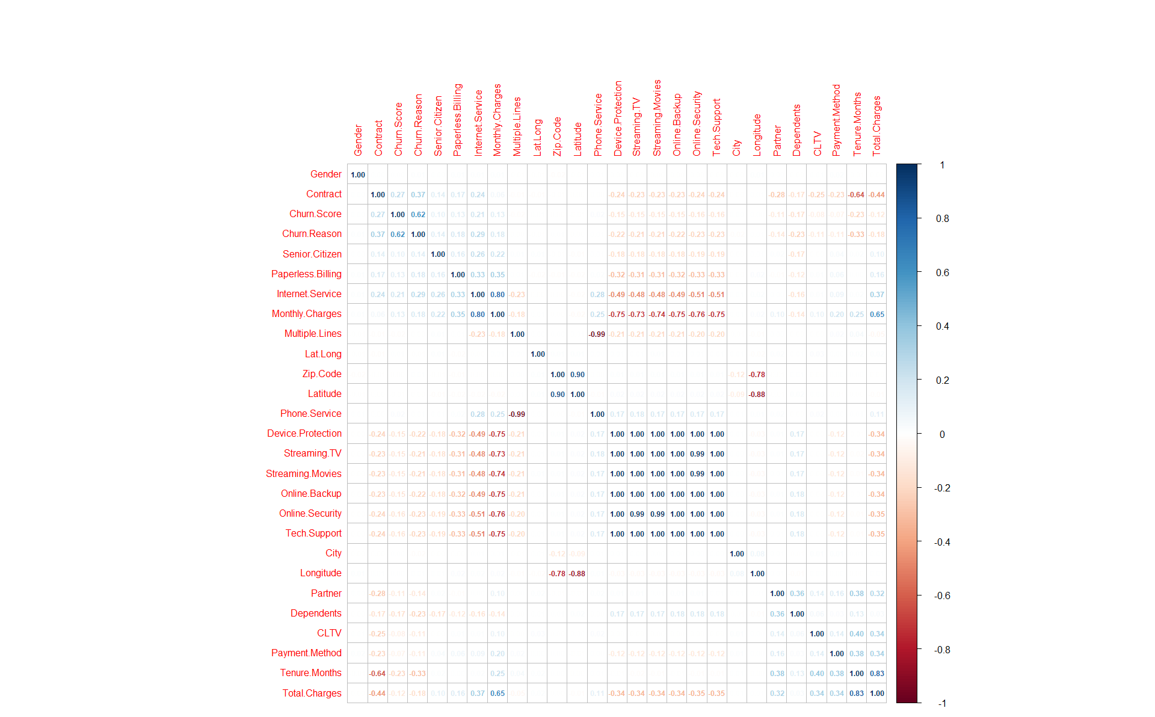
Insights and Interpretation
DATA ENGINEERING
28 Attributes
feature Selection
Model Optimization
19 Attributes
Tuning machine learning parameters (LAPLACE)
Compared the Results of NB with All features vs Selected Features (varImp)
Normalisation
Over balancing the minority of 1's in target variable

Slide 7
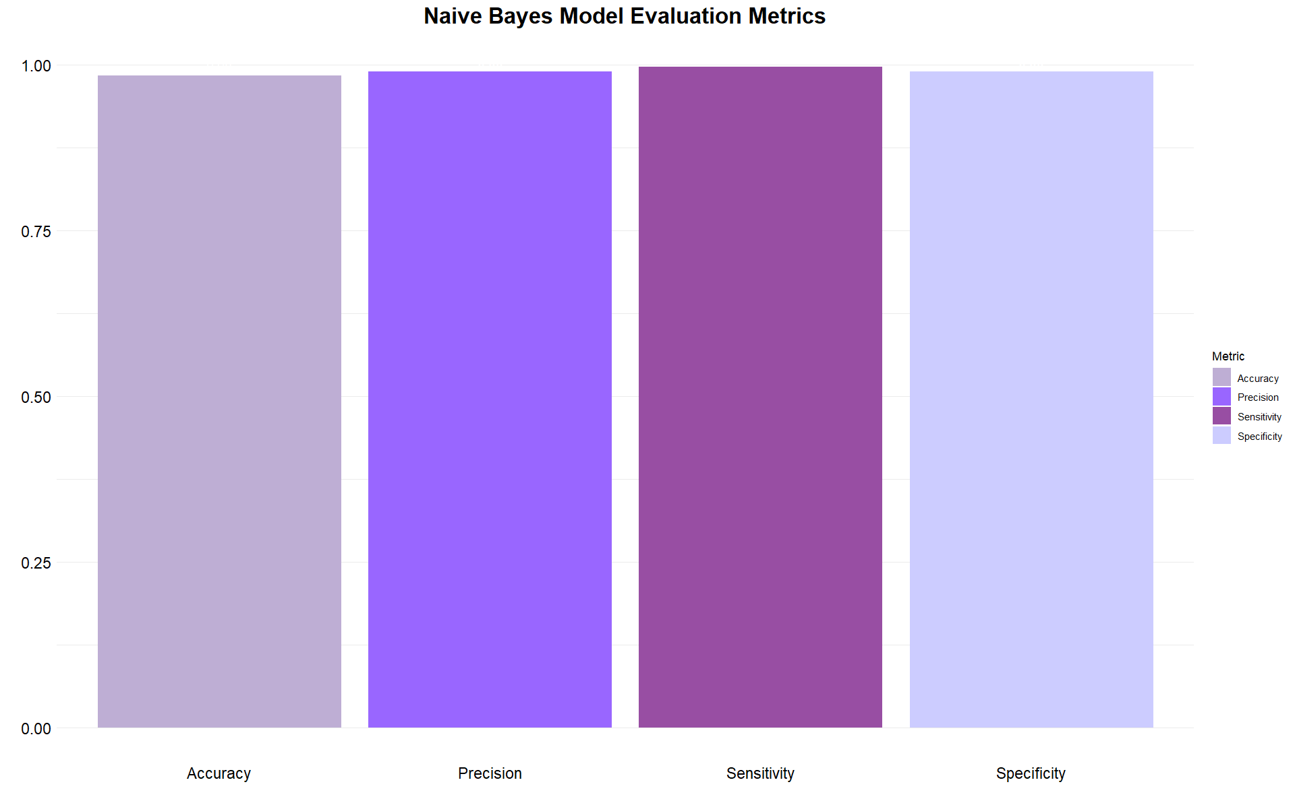
Key Findings & Insights
Balanced NAIVES BAYES
60:40
Based on the model:
Accuracy 98%
Precision 99%
Sensitivity 98%
Specificity 99%
Confusion Matrix - NB
 | Reference
Prediction | No | Yes
No | 2059 | 6
Yes | 41 | 706

Slide 8



Recommendations and Conclusion
Pay attention to competing company
Always provide customers with better offers.
Filter customers that:
Use Fiber-optic internet service
Do not have tech support or online security.
Do not have dependents or partners.
Use Paperless billing, pay monthly via electronic check
Pay great importance to new joining customers
(Paul, 2019)
Provide staff training for:
Consistent customer service.
Improve Customer Satisfaction
(Kostjuchenko, 2018)

Slide 9

THANK YOU

Slide 10
References:
Admin (2022) Naive Bayes classifier, arofiqimaulana.com. Available at: https://arofiqimaulana.com/naive-bayes-classifier/ (Accessed: 03 May 2023). ​
Armstrong, M. (2017) Sinking Ship Boat. Available at: https://www.armstrongeconomics.com/world-news/sovereign-debt-crisis/the-ship-is-sinking/ (Accessed: 05 May 2023). ​
Free vector: Flat design christmas town background (2019) Freepik. Available at: https://www.freepik.com/free-vector/flat-design-christmas-town-background_5831687.htm (Accessed: 03 May 2023). ​
Kostjuchenko, R. (2018) Standing business man teacher pointing with wooden pointer stick stock vector - illustration of icon, educator: 131128850, Dreamstime. Available at: https://www.dreamstime.com/standing-business-man-teacher-pointing-wooden-pointer-stick-standing-business-man-teacher-pointing-wooden-pointer-stick-image131128850 (Accessed: 03 May 2023).​
Paul, P. (2019) Man, call, head phone, 24 hours support, custom care , business customer support service purple color icon stock vector - illustration of business, magenta: 140921242, Dreamstime. Available at: https://www.dreamstime.com/man-call-head-phone-hours-support-custom-care-business-customer-support-service-purple-color-icon-icon-support-customer-service-image140921242 (Accessed: 03 May 2023) ​

Slide 11
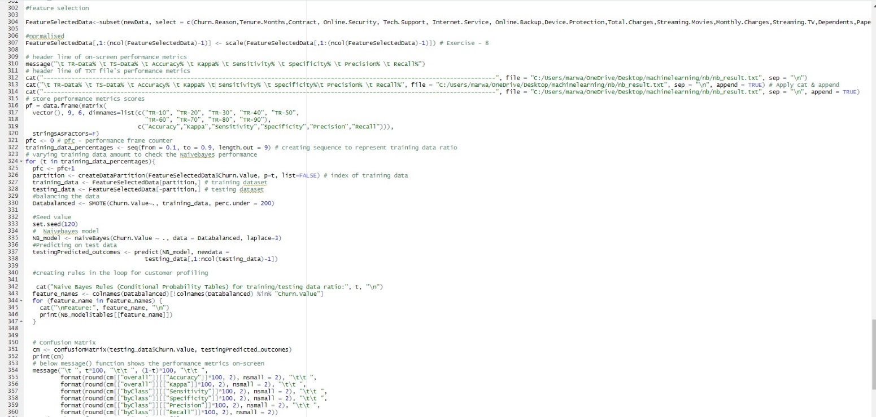
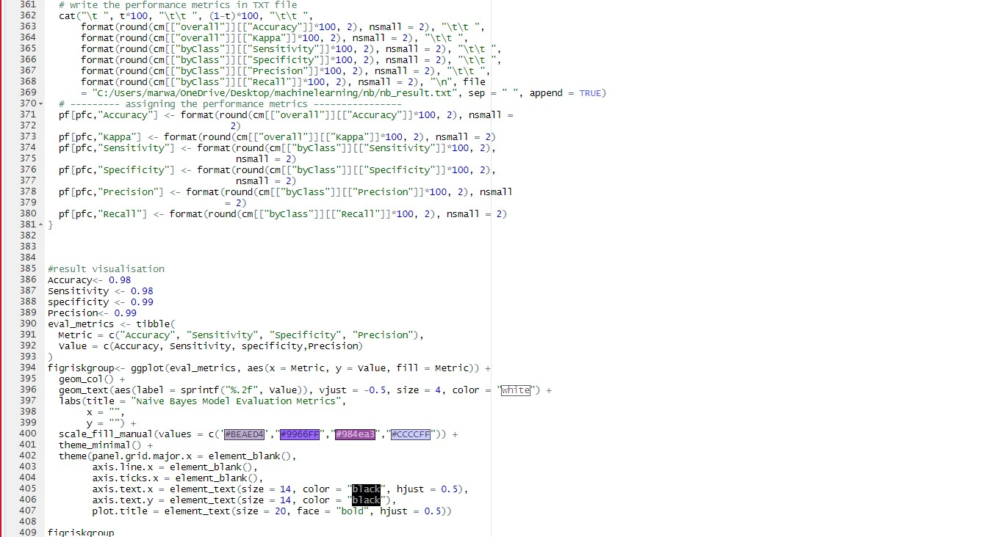
Appendix:Important Snippets from R script

